Slide 1

Javascript Basics (Data types)
by
M NAVEENKUMAR
Assistant Professor
Department of Computer Science and Engineering
SRI RAMACHANDRA ENGINEERING AND TECHNOLOGY
Sri Ramachandra Institute of Higher Education and Research

Slide 2
Data types in JS

Slide 3
Variables
var message = “hai” ;
keyword
Variable_name
value
A variable is a name associated with a piece of data
Variable = information container
In Js, Variable definition starts with ‘var’
Js is case sensitive
Js is dynamically typed language

Slide 4
Javascript : Data types
The values we assign to variables fall under a few distinct data types.
undefined
null
Numbers
Strings
Booleans
Array
Object
Primitive
Composite/reference

Slide 5
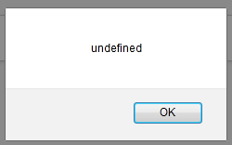
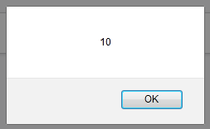
Data types :undefined
output
<script>
var myvar;
alert(myvar);
</script>
<script>
var myvar =10;
alert(myvar);
</script>
output

Slide 6
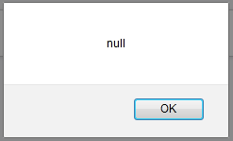
Data types :null
output
<script>
var myvar;
alert(myvar);
</script>
<script>
var myvar =null;
alert(myvar);
</script>
output

Slide 7
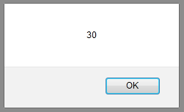
Data types :Numbers
<script>
var num1,num2;
var sum;
num1 = 10;
num2 = 20;
sum = num1 + num2;
alert(sum);
</script>
output

Slide 8
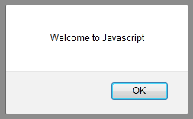
Data types : Strings
<script>
var str1,str2,str3;
str1 = "welcome to ";
str2 = 'javascript';
str3 = str1+str2;
alert(str3);
</script>
output

Slide 9
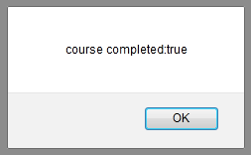
Data types : Booleans
Example
true
false
<script>
var course_completed;
course_completed = false;
course_completed = true;
alert('course completed:'+course_completed); <script>
Output

Slide 10
Static type vs Dynamic type
Static type
/* C code */
int num, sum; // explicit declaration
num = 5; // now use the variables
sum = 10;
sum = sum + num;
Dynamic type
/* python code */
num = 10 // directly using the variable
num = “my number”

Slide 11
Is JavaScript Static type or Dynamic type?

Slide 12
Challenge 3.1
Declare a variable x and assign value 10.
Declare a variable y and assign value 5.2.
Declare a variable z and assign value true.
Declare a variable str and assign value “welcome”
Print these variables to console.

Slide 13
Answer
<script>
var x = 10, y = 5.2, z= true;
var str = "welcome";
console.log(x);
console.log(x);
console.log(x);
console.log(x);
<script>

